Slide 1
Pathfinding Algorithms Visualized
By: Andrew Struthers

Slide 2
Introduction
Visualization for two different grid-based pathfinding algorithms
Grid of walkable and unwalkable tiles
A* and Breadth-First Search (BFS) algorithms
Create an executable that allows the user to specify the dimensions of the grid, mark the start and finish for the algorithm, and mark certain cells as “walls”, making those “walled” cells unwalkable

Slide 3
What is Pathfinding
A fundamental challenges when making realistic Artificial Intelligence (AI) in a computer game is agent movement
Pathfinding algorithms are a core part of AI movement system
Pathfinding algorithms must find a path from any coordinate in the game world to another
Pathfinders usually use some structure to guide movement. In this case, that predefined structure is a grid of nodes.
Pathfinding algorithms take a starting point and a destination point, then find a series of points through the predefined structure that forms a path to the destination
We usually only care about the shortest path from start to finish

Slide 4
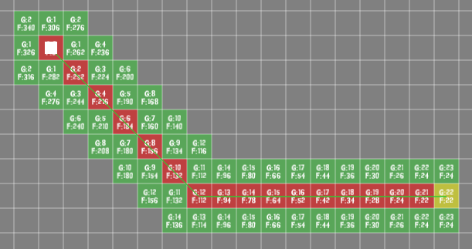
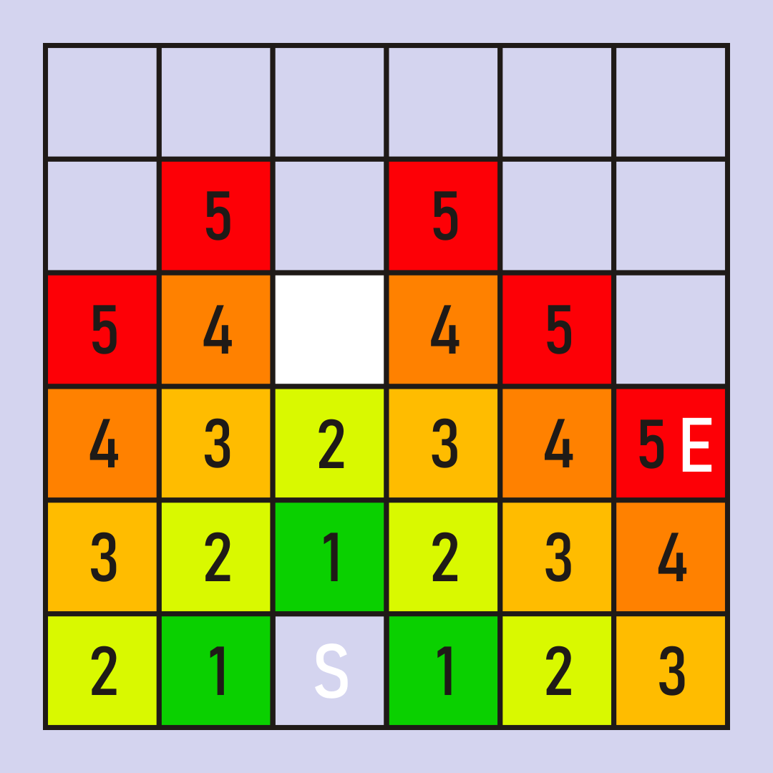
Pathfinding Overview
A* pathfinding calculates heuristic scores for each cell, and those scores determine the optimal path from start to finish.
BFS doesn’t use any heuristic calculations and instead checks the neighbors of each cell, adding the new cells to a queue, and creating a linked list able to be traversed to find the shortest number of cells from start to finish once the end has been found.

Slide 5
Theory Behind A*
Heuristically determine the shortest path between two nodes in a graph
A* pathfinding can work on any weighted or unweighted graph
This is one of the huge benefits of A* over BFS, which only works with unweighted graphs.
Each node in A* pathfinding has 3 values
G cost
H cost
F cost

Slide 6
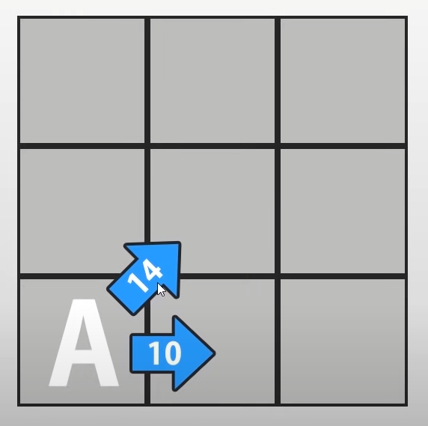
Theory Behind A* - G Cost
The walking cost from the start node
Moving left, right, up, or down costs 1.0
Moving diagonally in any direction costs 1.4
Because √(1^2+1^2) = √(2) ≈ 1.4
We want to work with integers, because they are nicer, so we multiply both by 10
Straight cost = 10
Diagonal cost = 14

Slide 7
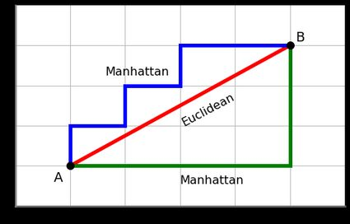
Theory Behind A* - H Cost
Heuristic cost to reach the end node, assuming we can move directly from the current node to the end node with no interruption
Also represents the “Manhattan Distance”, or “Grid Distance”
“Manhattan Distance”: distance metric between two points in a N dimensional vector space, sum of lengths of the projections of the line segment between the points onto the coordinate axes
Estimate cost to reach the goal without worrying about walls
Tells us which node we should prioritize first

Slide 8
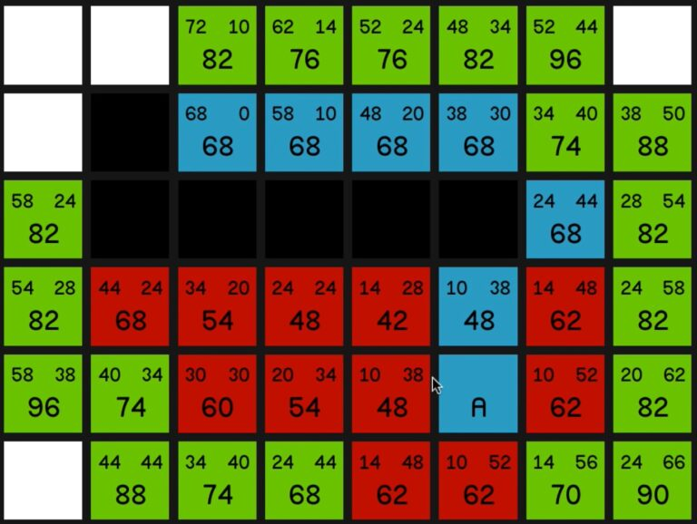
Theory Behind A* - F Cost
Simply the sum of our G cost and H cost
Simple heuristic cost that represents how far away this node is to the end
A* algorithm prioritizes nodes with the lowest F cost
Lower F cost nodes are more likely to be close to the end node
G cost is in top left corner
H cost is in top right corner
F cost is in the center
Notes:
The A∗ algorithm will check the lower f cost neighbors first, which is why there are multiple red nodes on the left of the A node. The algorithm knew that those tiles were closer to the goal, and tried to find a way around the wall by moving left first. Notice that, on the path that the algorithm eventually found, the G cost constantly increases whole the H cost constantly decreases. This means that the algorithm found a path where each node was closer to the goal than the previous node, which is exactly the behavior you would expect when finding the shortest path between two nodes. Once the goal node is reached, the path is traced back from final node to origin node. Each node knows the previous path node, so we can easily traverse this linked list to find our optimal path.

Slide 9
Theory Behind A*
The algorithm operates on two lists of nodes, known as the open list and the closed list
The open list is the list of all nodes queued up for searching
The closed list is the collection of all nodes that have already been searched
The algorithm will keep going until either the current node is the end node, or the open list is empty
Meaning there was no found path from start to finish

Slide 10
Theory Behind BFS
Breadth-First Search (BFS) is a simple graph traversal algorithm
BFS works by traversing each node in a graph until it reaches the goal node, storing a reference in each node to the parent of the current node
The traversal allows us to trace back the parent references such that we will have the shortest path from the end node to the origin node
One of the disadvantages of this algorithm over A* is that BFS only works on unweighted graphs
We are using a grid for navigation, so BFS can only traverse the graph in horizontal or vertical movements

Slide 11
Theory Behind BFS
We represent the grid as a network of nodes and edges
Each walkable tile next to the current tile will create an edge
Unwalkable tiles simply won’t create an edge to surrounding tiles
These nodes and edges form our pseudo linked list

Slide 12
Theory Behind BFS
BFS makes use of a queue data structure
The queue starts with the first node in our graph, then adds in all surrounding nodes to the queue
BFS iterates until the current node is equal to the final node, or all nodes have been searched
Each iteration, the algorithm pops the first element of the queue, checks its neighbors, and adds any node not in the queue to the end
BFS continues iterating until the end node has been found
Once the final node has been found, we can simply trace back the path using the parent references until we get back to the start.

Slide 13
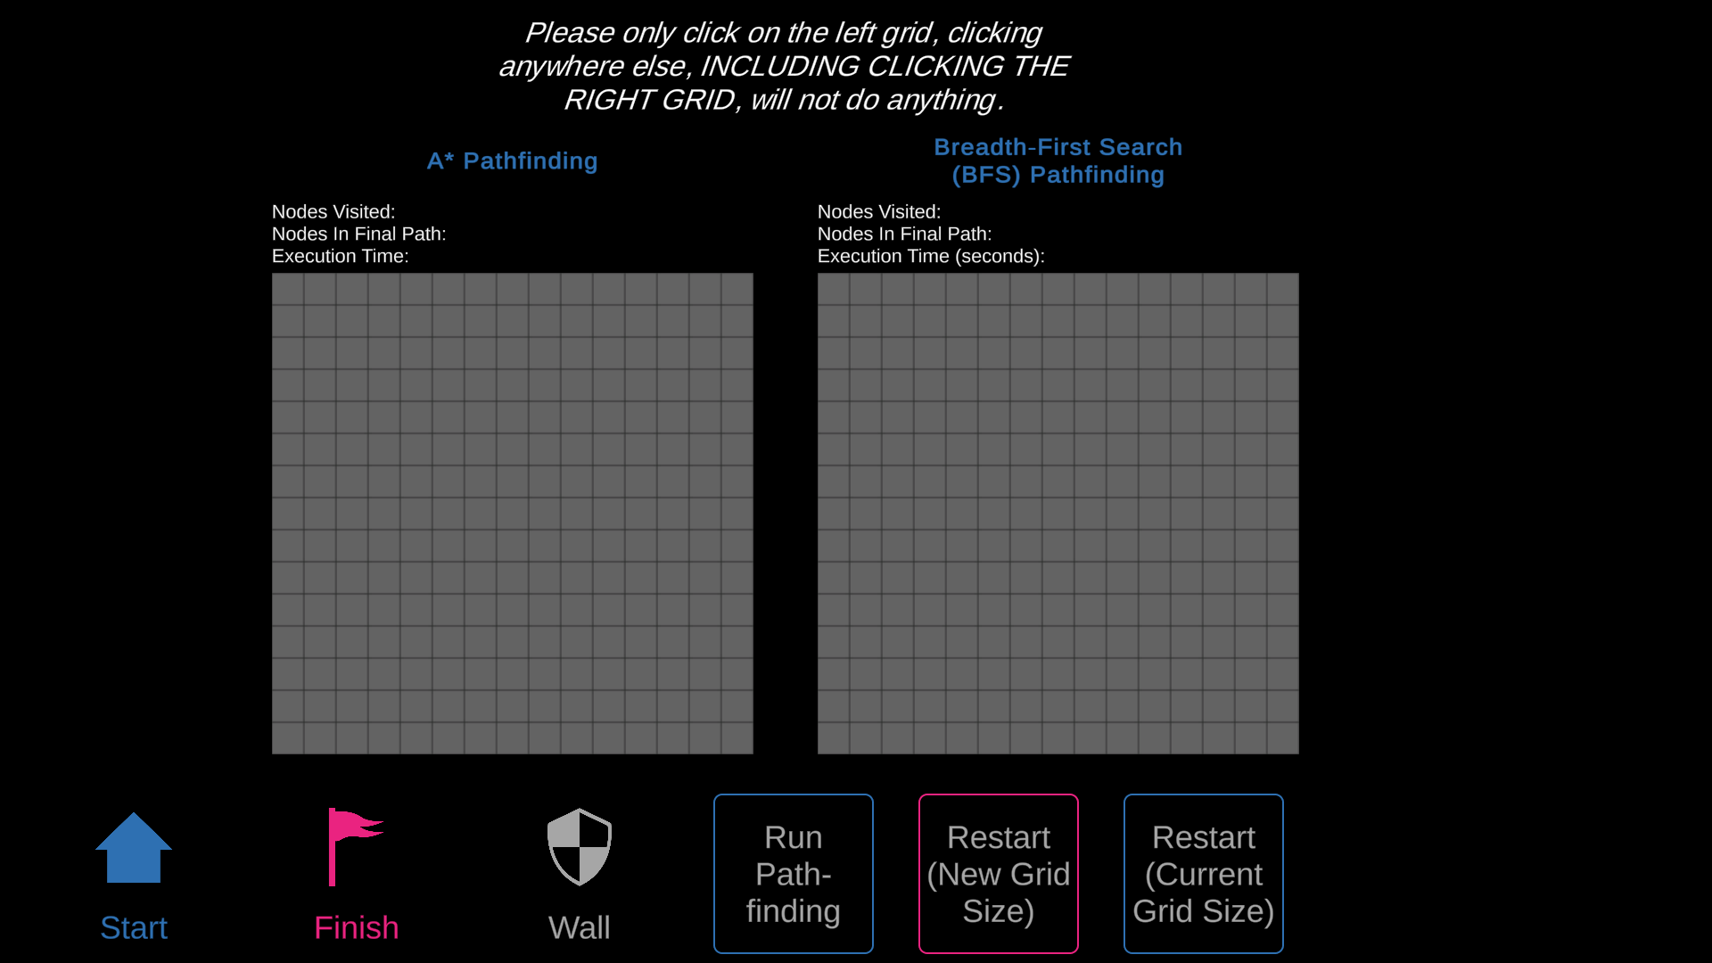
Software Demonstration

Slide 14
Interesting Findings
Big difference between the two algorithms
A* ends up pointing to the goal much sooner than BFS, due to the heuristics, but the runtimes to find the goal are similar
A* is much faster on large grids where the path is relatively unimpeded by walls
Despite differences between algorithms, they almost always find the same path, the BFS path is just the A* path without the diagonal movements

Slide 15
Interesting Findings
BFS can actually handle diagonal movement without any issues
But there is a slight problem with that
BFS evaluates the movement between nodes as though every movement cost the same amount
Because of BFS being unable to weight the movement costs, BFS with diagonal movement would not guarantee the shortest path
BFS would still find a path, but not necessarily the shortest path

Slide 16
Lessons Learned
A* pathfinding implementation can be improved
The heuristic equation we used here was a simple version of A*
There are more complicated heuristic models that increase performance
Additionally, finding the next lowest F cost node was done with linear search. Implementing a binary search or other algorithm could have increased performance
The “Nodes Visited” statistic is larger than the nodes visualized because I recalculated all of that node’s costs each time that node reappeared in the neighbor list
Each node was a TGridObject instead of a data oriented approach, where each of the nodes are represented by a struct. A data oriented approach could make use of high speed data types and optimization
With the optimization, A* can run much faster than BFS on any size or complexity of grid
In a real game scenario, this high-speed optimization would allow massive grids with many agents navigating throughout a complex world with very little runtime performance impact

Slide 17
Conclusion
I would implement more complicated weighted pathfinding algorithms Dijkstra’s pathfinding algorithm
It would be easy enough to extend the graph visualization and customization to handle more algorithms
I would also like to implement the data oriented approach to A* pathfinding
I am working on a large grid based combat game similar to XCom on my free time, so the lessons learned and experience gained from working on this project will directly impact in my game development efforts as well
https://github.com/AStruthers2000/PathfindingVisualizationStandaloneTool

Slide 18
References
Code Monkey. A* pathfinding in unity. YouTube, Oct 2019.
Nicholas Swift. Easy a* (star) pathfinding. Medium, May 2020.
Amit J. Patel. Introduction to a*. Amit’s Thoughts on Pathfinding, 2020.
Omar Elgabry. Path finding algorithms. Medium, Oct 2017.
Written by: Milos Simic. Tracing the path in dfs, bfs, and dijkstra’s algorithm. Baeldung on Computer Science, Nov 2022.
Raymond Kim. Bfs and dfs - path finding algorithms. Raymond Kim BFS DFS Pathfinding Algorithms, 2020.
TheHappieCat. How to do pathfinding: The basics (graphs, bfs, and dfs in unity). YouTube, May 2017.

